Slide 1
THE LIFE OF CHRIST
PART 28

Slide 2

Matthew 6:19 " Do not lay up for yourselves treasures on earth, where moth and rust destroy and where thieves break in and steal; ²⁰ "but lay up for yourselves treasures in heaven, where neither moth nor rust destroys and where thieves do not break in and steal. ²¹ "For where your treasure is, there your heart will be also. ²² " The lamp of the body is the eye. If therefore your eye is good, your whole body will be full of light. ²³ "But if your eye is bad, your whole body will be full of darkness. If therefore the light that is in you is darkness, how great is that darkness! ²⁴ " No one can serve two masters; for either he will hate the one and love the other, or else he will be loyal to the one and despise the other. You cannot serve God and mammon.

Slide 3


Slide 4
1 Timothy 6:9 But those who desire to be rich fall into temptation and a snare, and into many foolish and harmful lusts which drown men in destruction and perdition. ¹⁰ For the love of money is a root of all kinds of evil, for which some have strayed from the faith in their greediness, and pierced themselves through with many sorrows.

Slide 5
Mark 14:21 … woe to that man by whom the Son of Man is betrayed! It would have been good for that man if he had never been born."

Slide 6
Matthew 6:24 " No one can serve two masters; for either he will hate the one and love the other, or else he will be loyal to the one and despise the other. You cannot serve God and mammon.

Slide 7
Matthew 6:19" Do not lay up for yourselves treasures on earth, where moth and rust destroy and where thieves break in and steal; ²⁰ "but lay up for yourselves treasures in heaven, where neither moth nor rust destroys and where thieves do not break in and steal. ²¹ "For where your treasure is, there your heart will be also.

Slide 8
Matthew 16:26 "For what profit is it to a man if he gains the whole world, and loses his own soul? Or what will a man give in exchange for his soul?

Slide 9
Matthew 19:16 Now behold, one came and said to Him, "Good Teacher, what good thing shall I do that I may have eternal life?" ¹⁷ So He said to him, "Why do you call Me good? No one is good but One, that is, God. But if you want to enter into life, keep the commandments." ¹⁸ He said to Him, "Which ones?" Jesus said, " 'You shall not murder,' 'You shall not commit adultery,' 'You shall not steal,' 'You shall not bear false witness,' ¹⁹ 'Honor your father and your mother,' and, 'You shall love your neighbor as yourself.' " ²⁰ The young man said to Him, "All these things I have kept from my youth. What do I still lack?"

Slide 10
²¹ Jesus said to him, "If you want to be perfect, go, sell what you have and give to the poor, and you will have treasure in heaven; and come, follow Me." ²² But when the young man heard that saying, he went away sorrowful, for he had great possessions. ²³ Then Jesus said to His disciples, "Assuredly, I say to you that it is hard for a rich man to enter the kingdom of heaven. ²⁴ "And again I say to you, it is easier for a camel to go through the eye of a needle than for a rich man to enter the kingdom of God."

Slide 11
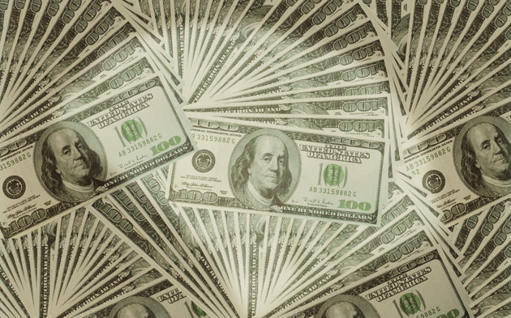

Slide 12
Daniel 6:4 So the governors and satraps sought to find some charge against Daniel concerning the kingdom; but they could find no charge or fault, because he was faithful; nor was there any error or fault found in him. ⁵ Then these men said, "We shall not find any charge against this Daniel unless we find it against him concerning the law of his God." ⁶ So these governors and satraps thronged before the king, and said thus to him: "King Darius, live forever!

Slide 13
⁷ "All the governors of the kingdom, the administrators and satraps, the counselors and advisors, have consulted together to establish a royal statute and to make a firm decree, that whoever petitions any god or man for thirty days, except you, O king, shall be cast into the den of lions. ⁸ "Now, O king, establish the decree and sign the writing, so that it cannot be changed, according to the law of the Medes and Persians, which does not alter." ⁹ Therefore King Darius signed the written decree.

Slide 14
Daniel 6:10 Now when Daniel knew that the writing was signed, he went home. And in his upper room, with his windows open toward Jerusalem, he knelt down on his knees three times that day, and prayed and gave thanks before his God, as was his custom since early days. ¹¹ Then these men assembled and found Daniel praying and making supplication before his God.

Slide 15
¹² And they went before the king, and spoke concerning the king's decree: "Have you not signed a decree that every man who petitions any god or man within thirty days, except you, O king, shall be cast into the den of lions?" The king answered and said, "The thing is true, according to the law of the Medes and Persians, which does not alter." ¹³ So they answered and said before the king, "That Daniel, who is one of the captives from Judah, does not show due regard for you, O king, or for the decree that you have signed, but makes his petition three times a day."

Slide 16
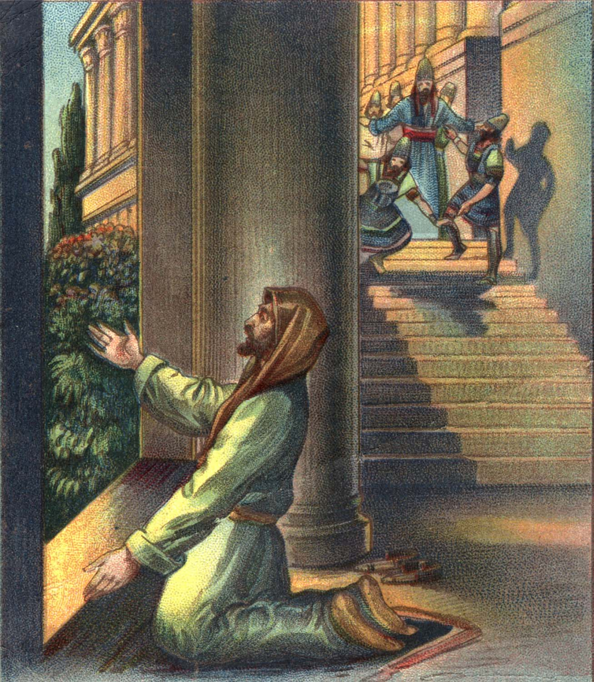

Slide 17
1 Timothy 6:6 Now godliness with contentment is great gain. ⁷ For we brought nothing into this world, and it is certain we can carry nothing out. ⁸ And having food and clothing, with these we shall be content.
Ecclesiastes 5:15 As he came from his mother's womb, naked shall he return, To go as he came; And he shall take nothing from his labor Which he may carry away in his hand.

Slide 18
1 Timothy 6:17 Command those who are rich in this present age not to be haughty, nor to trust in uncertain riches but in the living God, who gives us richly all things to enjoy. ¹⁸ Let them do good, that they be rich in good works, ready to give, willing to share, ¹⁹ storing up for themselves a good foundation for the time to come, that they may lay hold on eternal life.

Slide 19
Proverbs 23:4 Do not overwork to be rich; Because of your own understanding, cease! ⁵ Will you set your eyes on that which is not? For riches certainly make themselves wings; They fly away like an eagle toward heaven.

Slide 20
Proverbs 30:7 Two things I request of You (Deprive me not before I die): ⁸ Remove falsehood and lies far from me; Give me neither poverty nor riches -- Feed me with the food allotted to me; ⁹ Lest I be full and deny You, And say, "Who is the LORD?" Or lest I be poor and steal, And profane the name of my God.

Slide 21
Philippians 4:11 Not that I speak in regard to need, for I have learned in whatever state I am, to be content: ¹² I know how to be abased, and I know how to abound. Everywhere and in all things I have learned both to be full and to be hungry, both to abound and to suffer need. ¹³ I can do all things through Christ who strengthens me.

Slide 22
Ecclesiastes 7:1 A good name is better than precious ointment,
Proverbs 22:1 A good name is to be chosen rather than great riches, Loving favor rather than silver and gold. ² The rich and the poor have this in common, The LORD is the maker of them all.

Slide 23
1 Peter 3:15 But sanctify the Lord God in your hearts, and always be ready to give a defense to everyone who asks you a reason for the hope that is in you, with meekness and fear; ¹⁶ having a good conscience, that when they defame you as evildoers, those who revile your good conduct in Christ may be ashamed.

Slide 24
Proverbs 19:4 Wealth makes many friends, But the poor is separated from his friend.

Slide 25
Proverbs 17:17 A friend loves at all times

Slide 26
1 Samuel 19:1 Now Saul spoke to Jonathan his son and to all his servants, that they should kill David; but Jonathan, Saul's son, delighted greatly in David. ² So Jonathan told David, saying, "My father Saul seeks to kill you. Therefore please be on your guard until morning, and stay in a secret place and hide. ³ "And I will go out and stand beside my father in the field where you are, and I will speak with my father about you. Then what I observe, I will tell you." ⁴ Thus Jonathan spoke well of David to Saul his father, and said to him, "Let not the king sin against his servant, against David, because he has not sinned against you, and because his works have been very good toward you.

Slide 27
⁵ "For he took his life in his hands and killed the Philistine, and the LORD brought about a great deliverance for all Israel. You saw it and rejoiced. Why then will you sin against innocent blood, to kill David without a cause?" ⁶ So Saul heeded the voice of Jonathan, and Saul swore, "As the LORD lives, he shall not be killed."

Slide 28
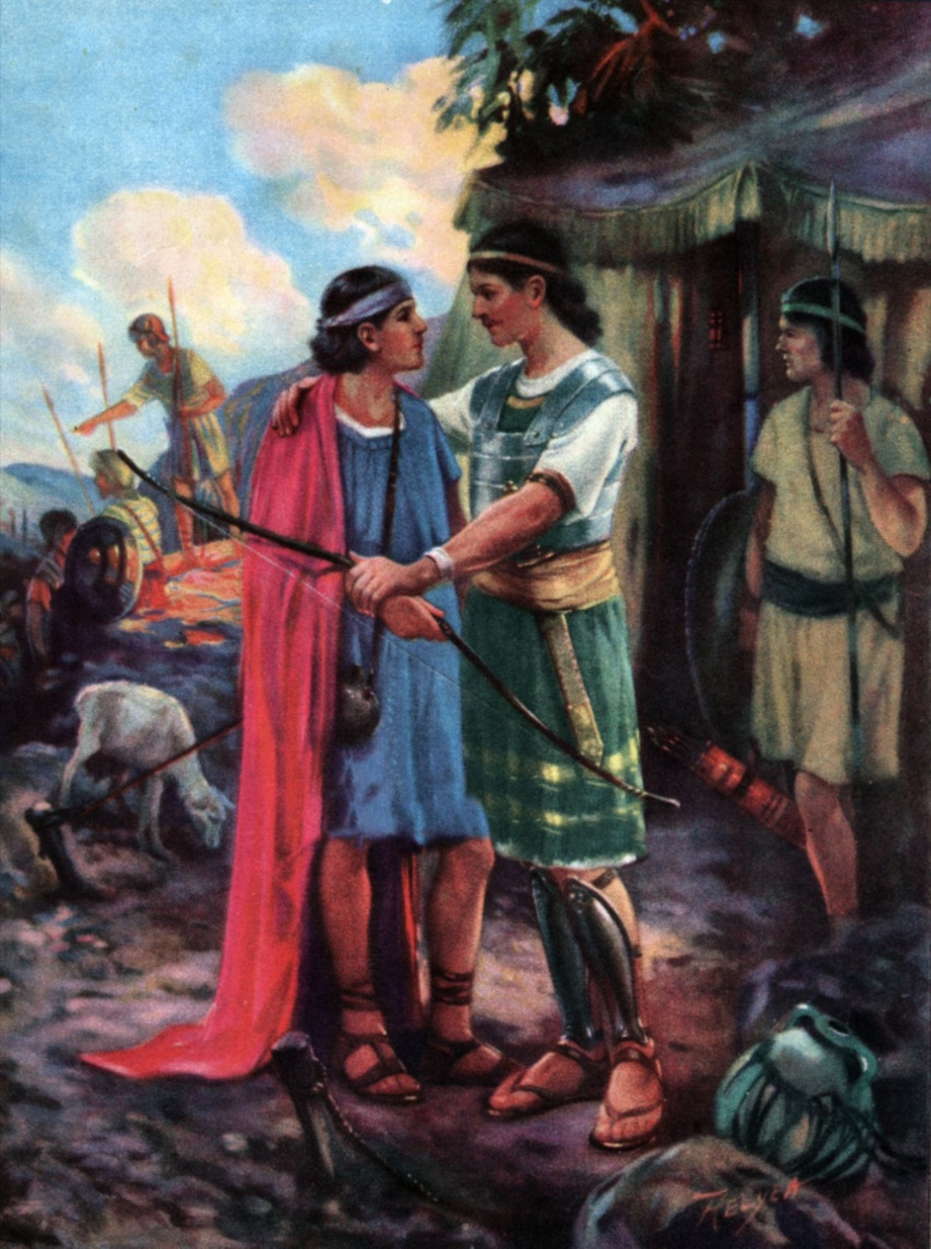

Slide 29
Proverbs 18:24 A man who has friends must himself be friendly, But there is a friend who sticks closer than a brother.

Slide 30
Luke 15:11 Then He said: "A certain man had two sons. ¹² "And the younger of them said to his father, 'Father, give me the portion of goods that falls to me.' So he divided to them his livelihood. ¹³ "And not many days after, the younger son gathered all together, journeyed to a far country, and there wasted his possessions with prodigal living. ¹⁴ "But when he had spent all, there arose a severe famine in that land, and he began to be in want. ¹⁵ "Then he went and joined himself to a citizen of that country, and he sent him into his fields to feed swine.

Slide 31
¹⁶ "And he would gladly have filled his stomach with the pods that the swine ate, and no one gave him anything. ¹⁷ "But when he came to himself, he said, 'How many of my father's hired servants have bread enough and to spare, and I perish with hunger! ¹⁸ 'I will arise and go to my father, and will say to him, "Father, I have sinned against heaven and before you, ¹⁹ "and I am no longer worthy to be called your son. Make me like one of your hired servants." '

Slide 32
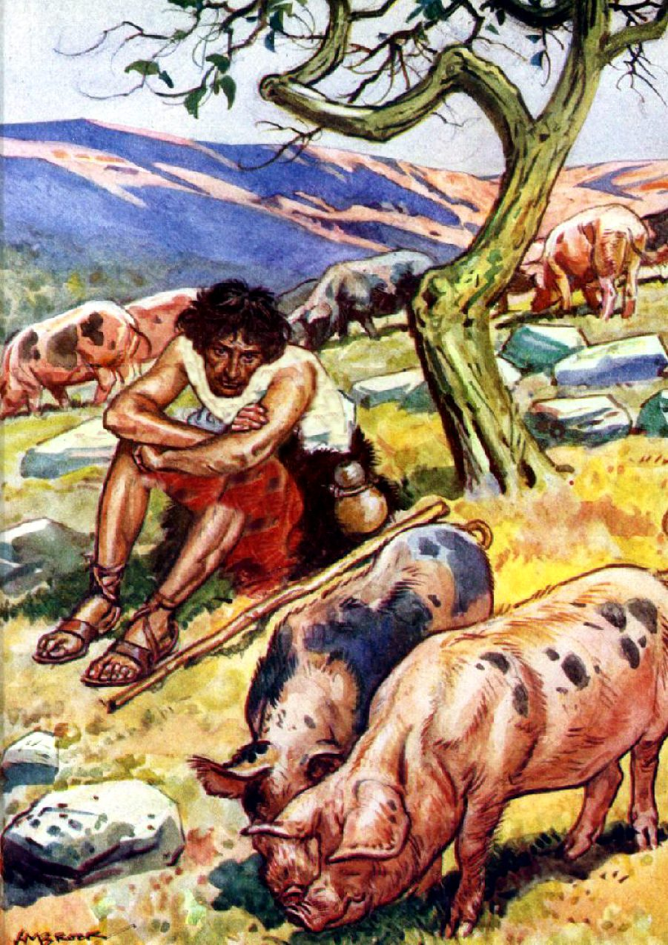

Slide 33
Ecclesiastes 5:10 He who loves silver will not be satisfied with silver; Nor he who loves abundance, with increase. This also is vanity. ¹¹ When goods increase, They increase who eat them; So what profit have the owners Except to see them with their eyes?

Slide 34
Ecclesiastes 12:13 Let us hear the conclusion of the whole matter: Fear God and keep His commandments, For this is man's all. ¹⁴ For God will bring every work into judgment, Including every secret thing, Whether good or evil.

Slide 35
Psalm 146:5 Happy is he who has the God of Jacob for his help, Whose hope is in the LORD his God,

Slide 36
Luke 12:15 And He said to them, "Take heed and beware of covetousness, for one's life does not consist in the abundance of the things he possesses." ¹⁶ Then He spoke a parable to them, saying: "The ground of a certain rich man yielded plentifully. ¹⁷ "And he thought within himself, saying, 'What shall I do, since I have no room to store my crops?' ¹⁸ "So he said, 'I will do this: I will pull down my barns and build greater, and there I will store all my crops and my goods.

Slide 37
¹⁹ 'And I will say to my soul, "Soul, you have many goods laid up for many years; take your ease; eat, drink, and be merry." ' ²⁰ "But God said to him, 'Fool! This night your soul will be required of you; then whose will those things be which you have provided?' ²¹ "So is he who lays up treasure for himself, and is not rich toward God."

Slide 38
